Slide 1
Employer portal demo
Copyright ©2022 Akeso Occupational Health

Slide 2
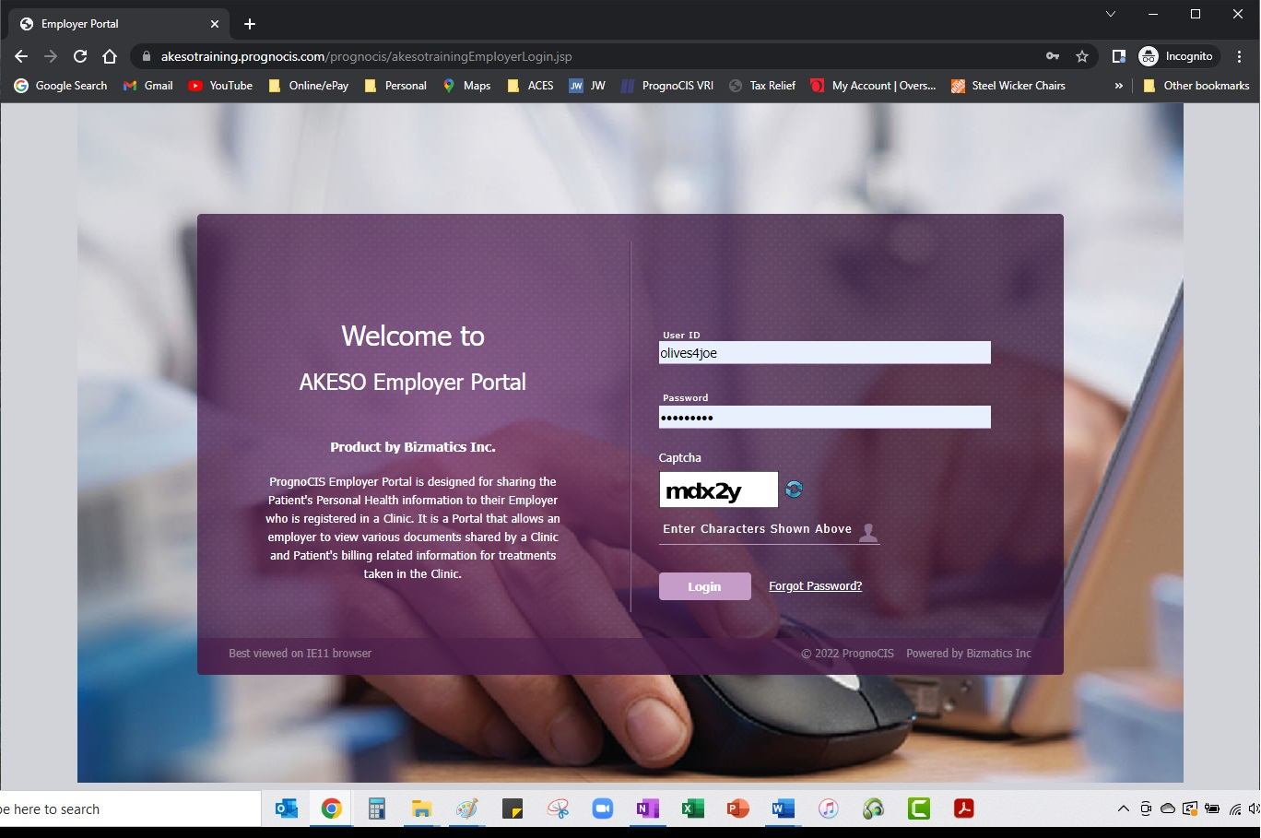
Logon Page
Secure user access managed
internally

Slide 3
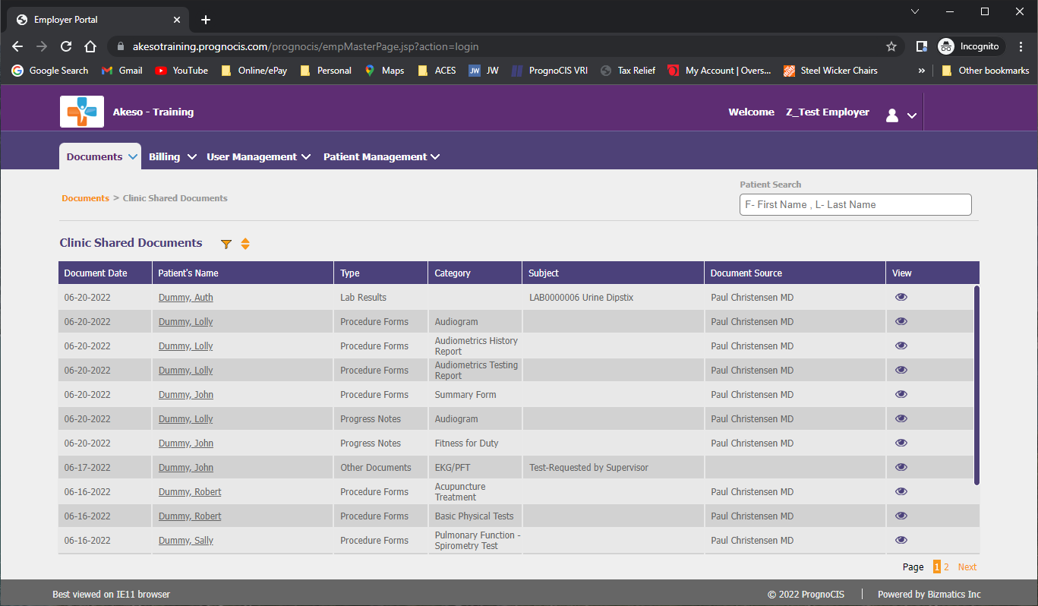
Home Page → Clinic Shared Documents
Relevant clinical details available following patient visit

Slide 4
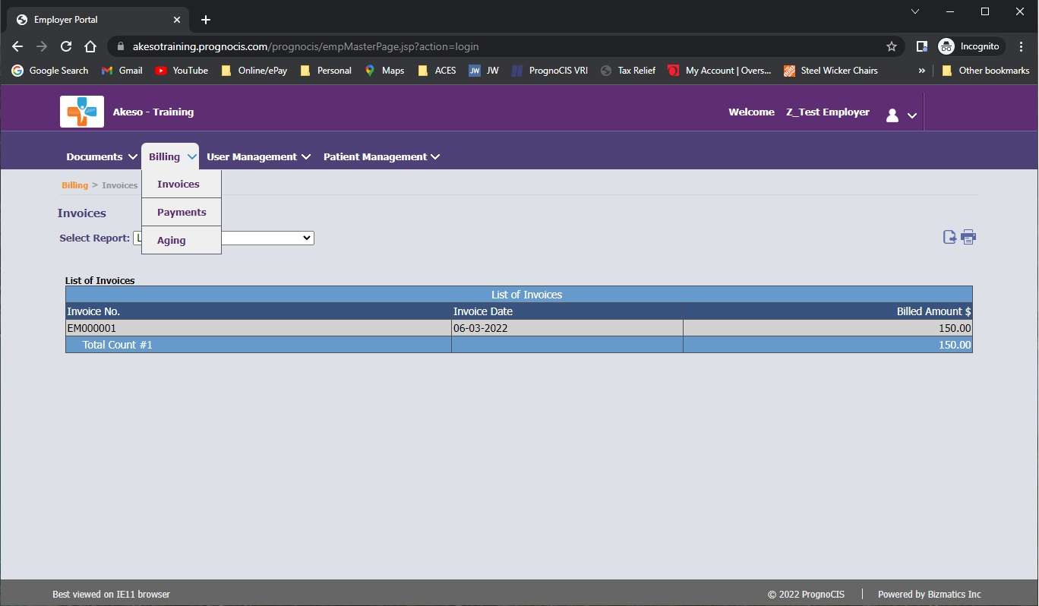
Billing Tab
Track invoices, payments, and AR aging

Slide 5
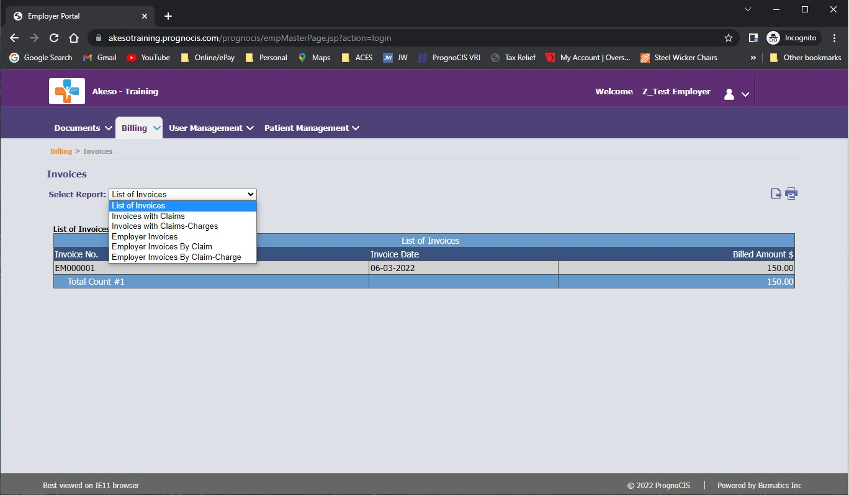
Billing Tab → Invoices
Summary and detail reports of billed services

Slide 6
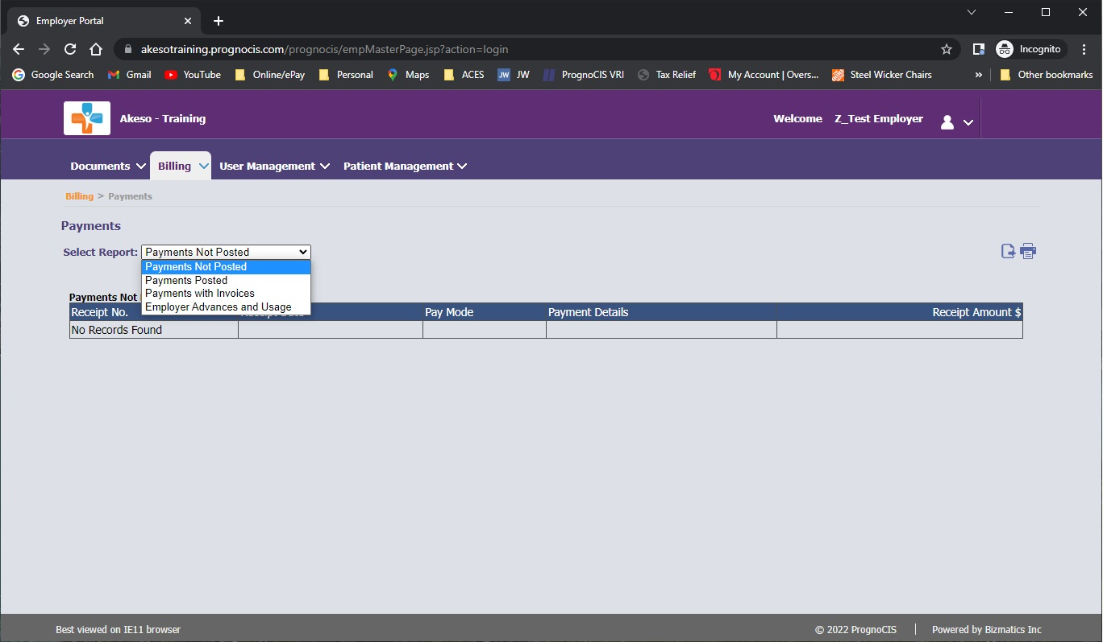
Billing Tab → Payments
Summary and detail reports of payments issued

Slide 7
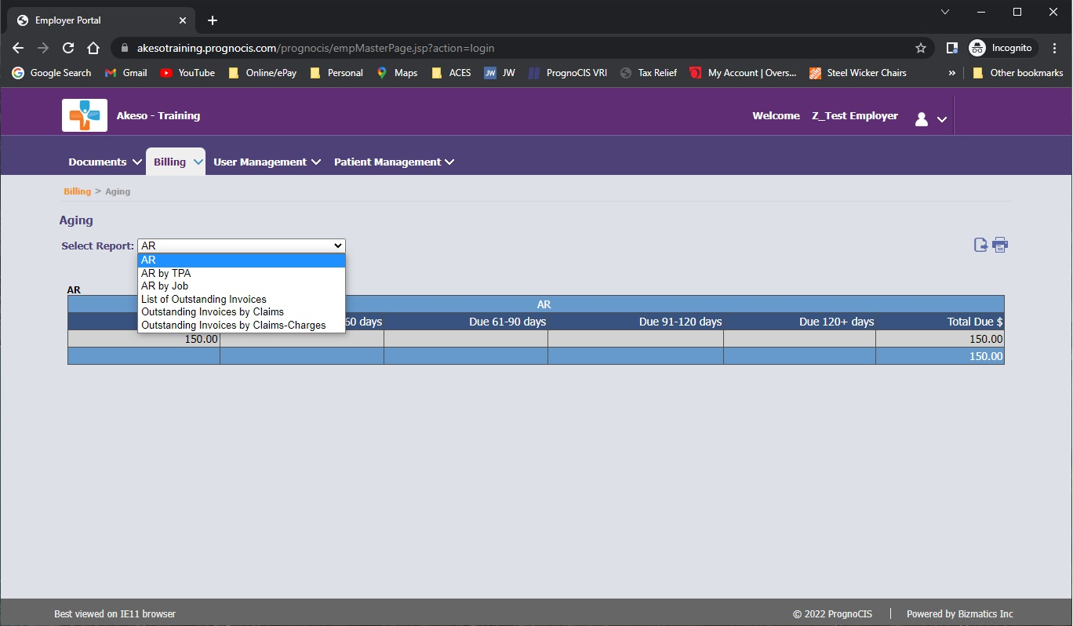
Billing Tab → AR Aging
Summary and detail AR by Job or by TPA source

Slide 8
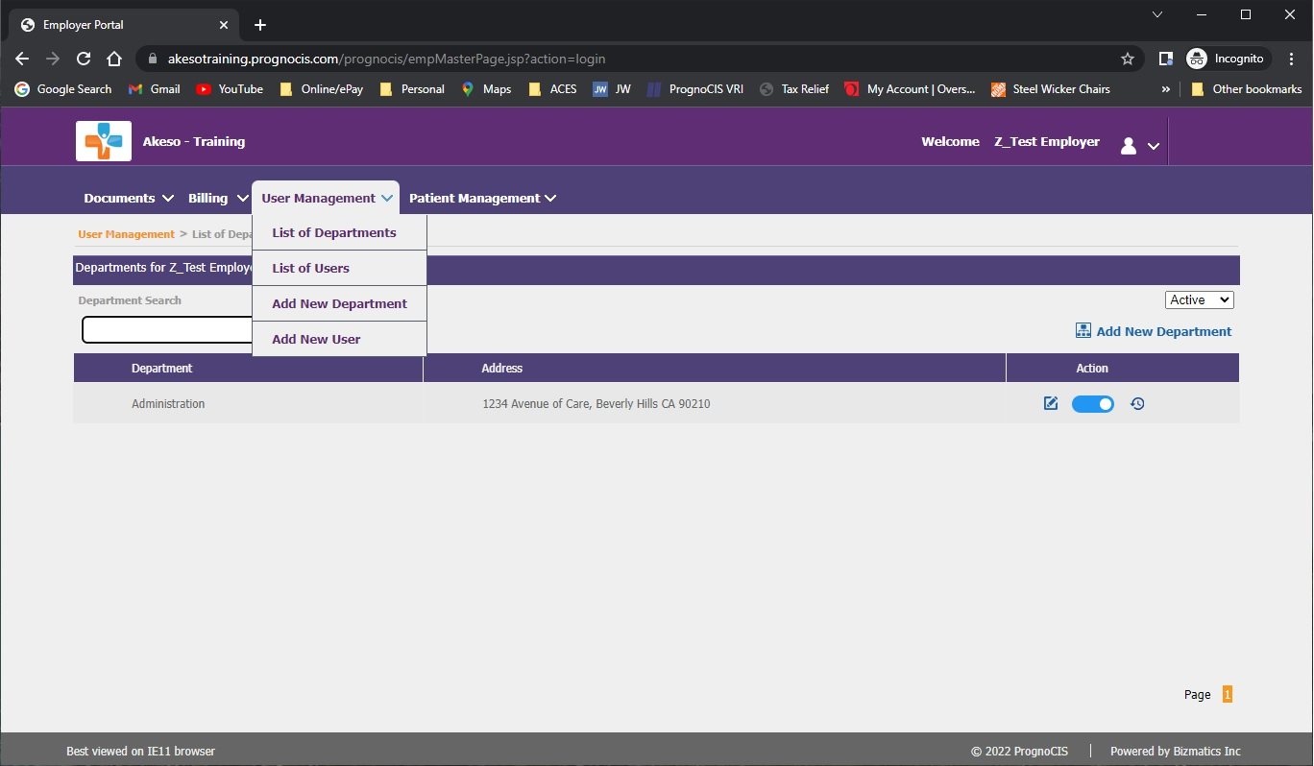
User Management Tab → List of Departments
Manage access for business operations

Slide 9
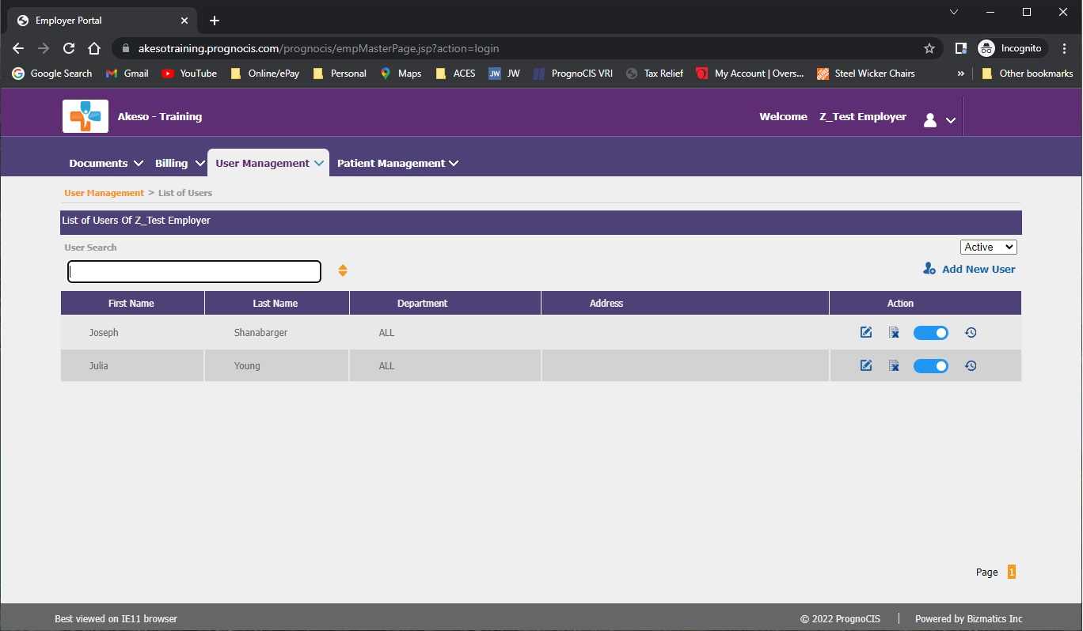
User Management Tab → List of Users
Manage details and access for business users

Slide 10
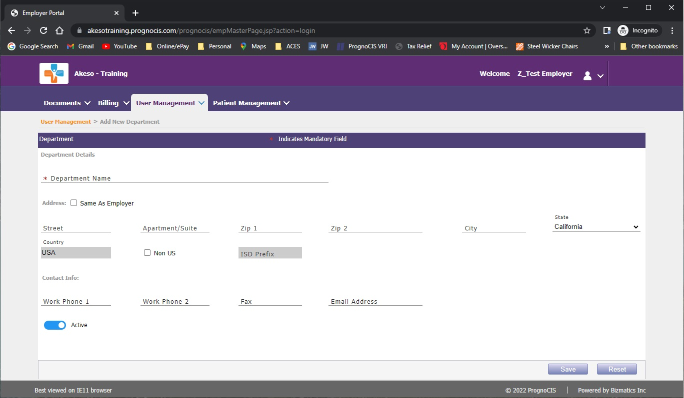
User Management Tab → Add New Department
Add details and access for new departments

Slide 11
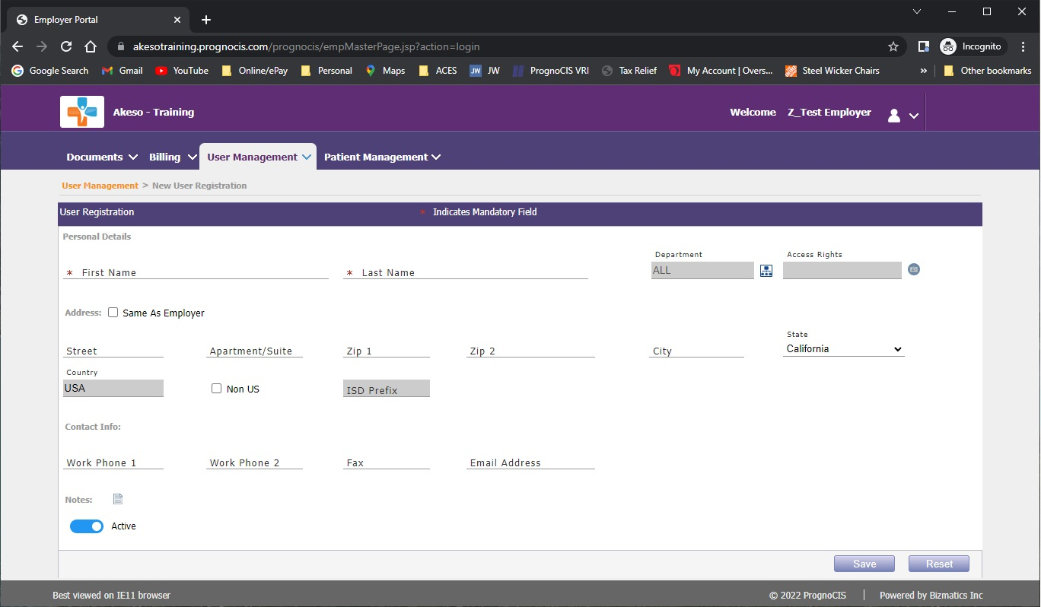
User Management Tab → Add New User
Add details and access for new users

Slide 12
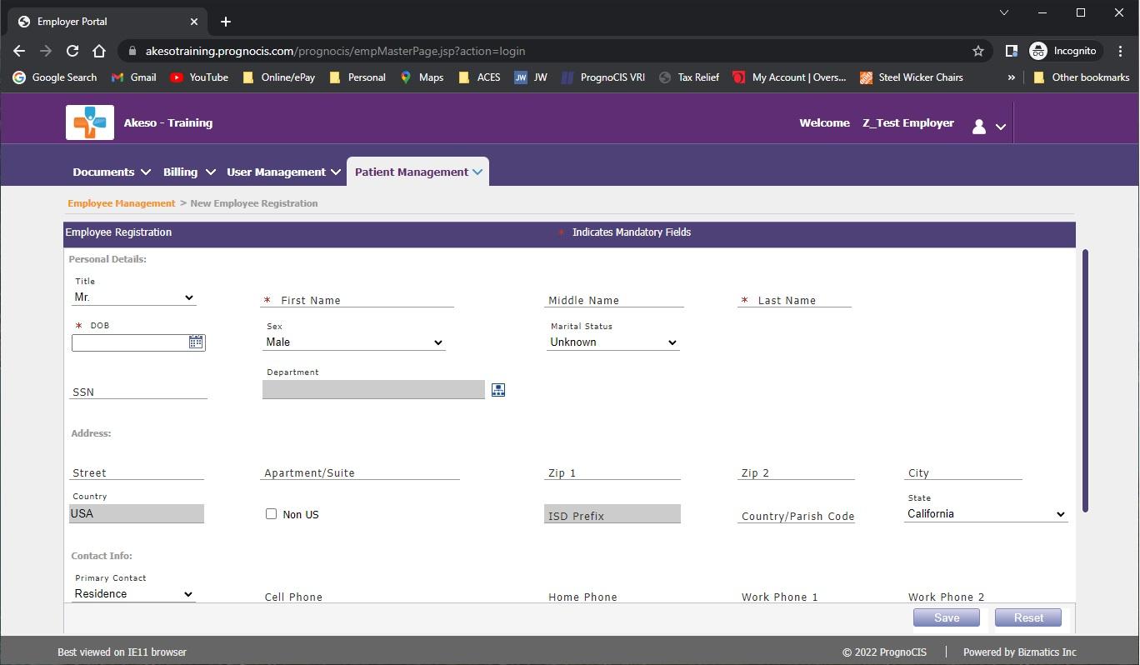
Patient Management Tab → Add New Employee
Add details for new employees (patients)

Slide 13
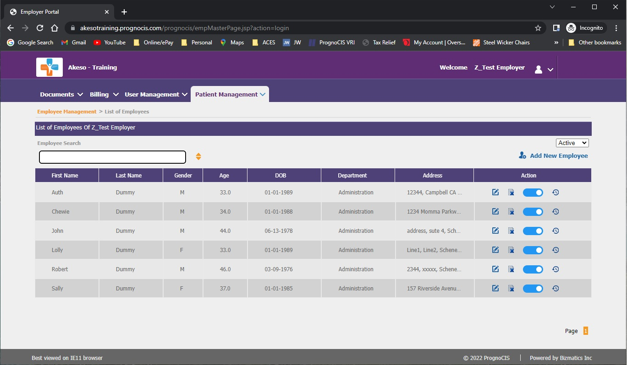
Patient Management Tab → List of Employees
Search/Manage employees (patients)

Slide 14
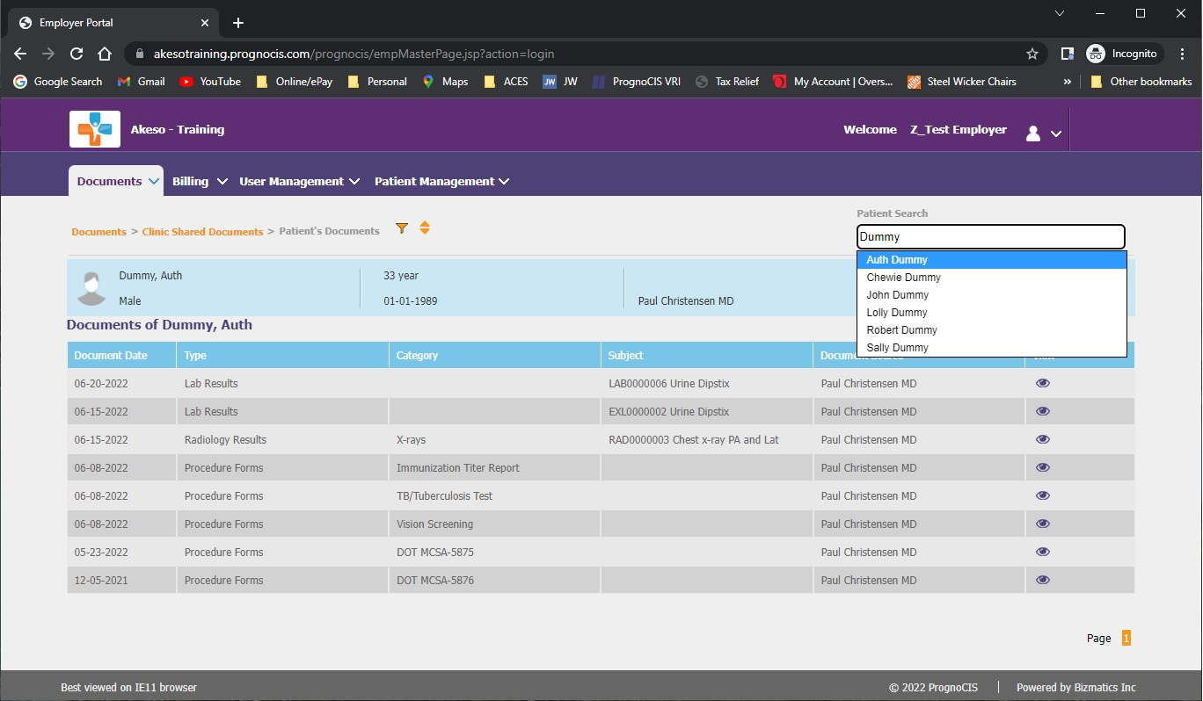
Patient Search/Individual Records
Individual employee search & patient records

Slide 15
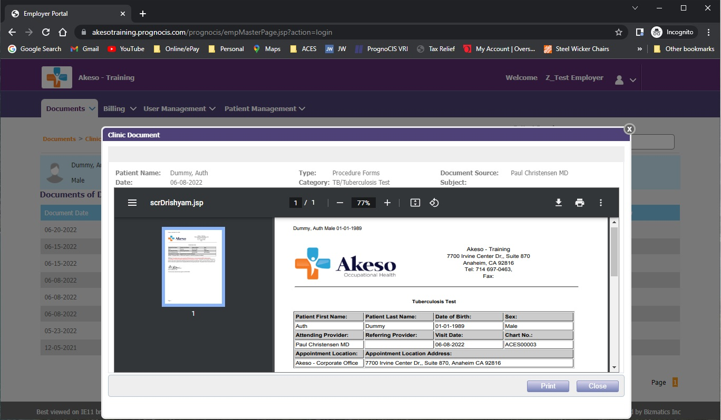
Document Preview
View records on screen or print hard copy

Slide 16
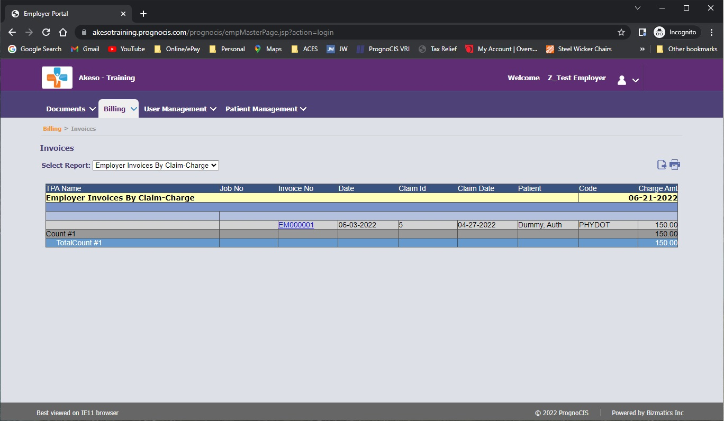
Export/Print Lists and Reports
Export details to Excel or print as hard copy

Slide 17
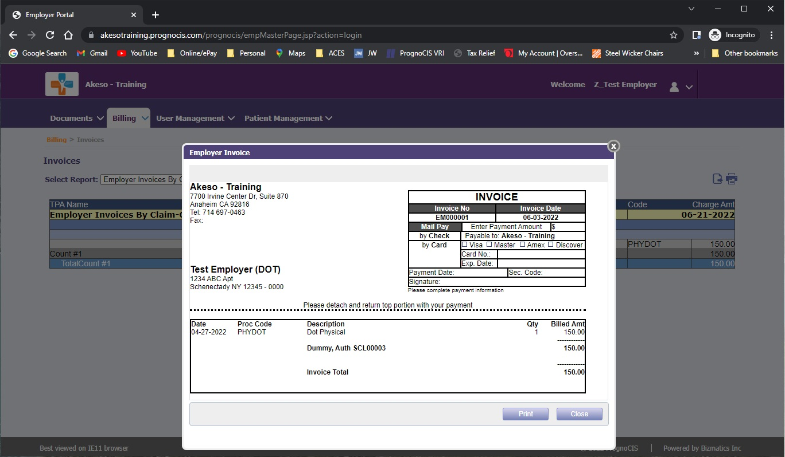
View Hyperlink Contents on Screen
View details on screen or print hard copy

